Slide 1
ASL Fingerspelling Recognition
</
/>
Group 5
By:
Jamie Wu
Seok Hyun Kim
Fabiola Gallardo
Imran Omari
Gautham Sivakumar

Slide 2

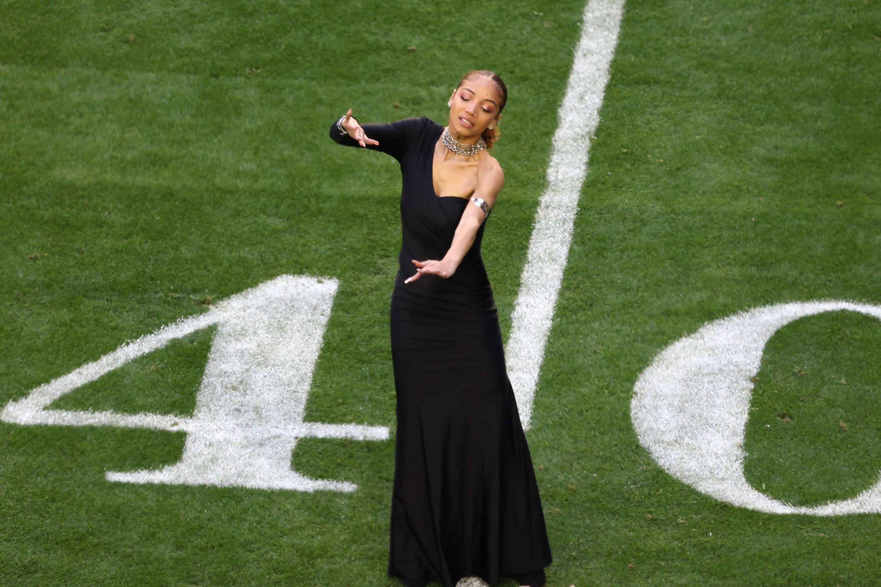


</Introduction
Notes:
Fabiola-
"hello everyone we are group 5 and I am Fabiola, the rest of the group introduce, for our project we did a literature review for a kaggle notebook from the Google competition ASL-to-text transformer prediction model". We came to choosing this project because of Justina Miles. She is ASL interpreter who performed at Rihanna's Superbowl performance and her interpretations were considered to be a prime example of making the media more accessible for deaf or hard of hearing people. the problem of asl-to-text is a topic coming to the foreground the slide shows a few diff companies that are all working on talking this issue. To contribute to what these companies are doing our goal is to emulate ASL fingerspelling into text predictions from the top three notebooks."

Slide 3
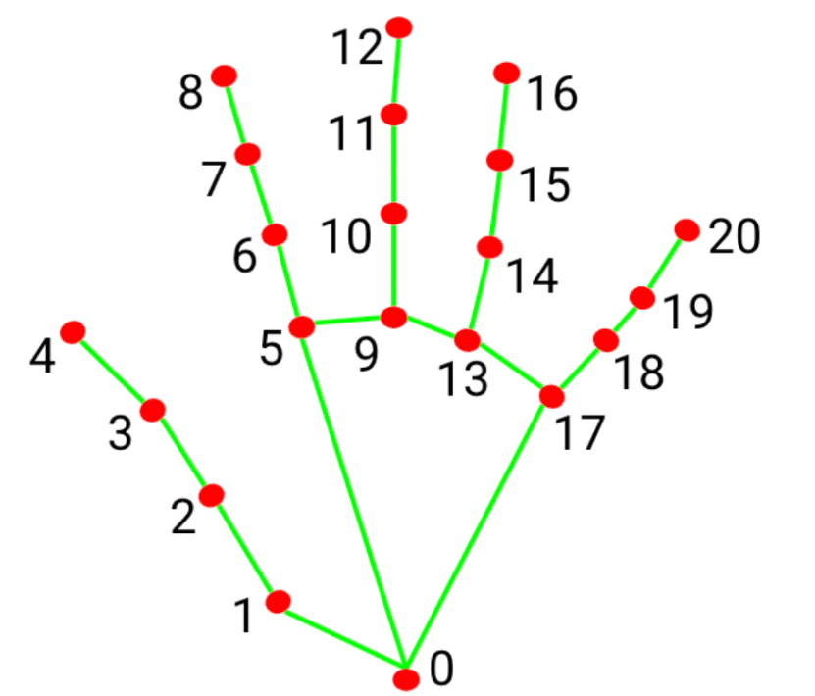
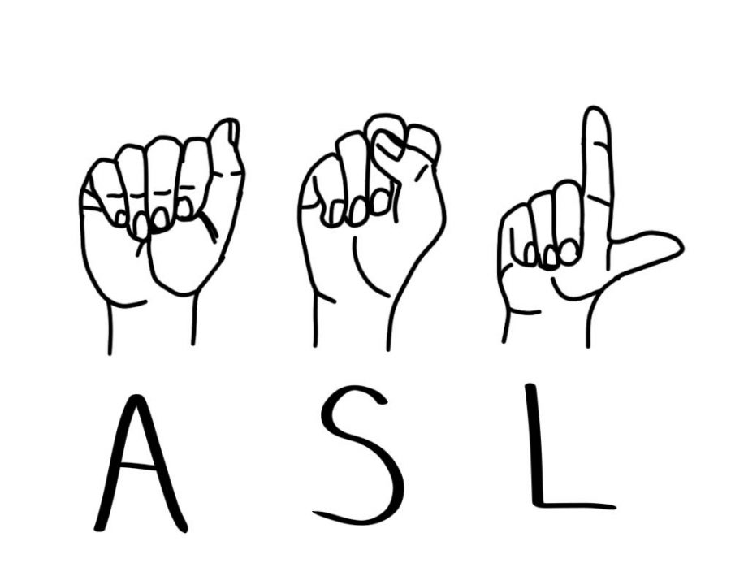
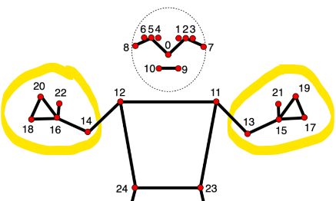
</Background
Notes:
Imran
Visual Language: ASL relies on visual communication through handshapes, facial expressions, and body movements.
Distinct Grammar: ASL has its own grammar and sentence structure different from spoken English.
Manual Alphabet: Fingerspelling is used to spell out words using the ASL manual alphabet.
Non-Manual Markers: Facial expressions, head movements, and eye gaze convey nuances in ASL.
MediaPipe: MediaPipe is an open-source framework developed by Google that provides tools and solutions for building applications that involve real-time perception of human actions, gestures, and objects. It is primarily used for computer vision and machine learning tasks related to video and camera input. MediaPipe offers pre-trained machine learning models, as well as a set of customizable pipelines and components, making it easier for developers to create applications that can understand and interpret visual data.
Landmark!

Slide 4





</Methodology - Data Processing
68 -> 15, 25GB
15,000 phrases
Notes:
Jamie - 1 minute
As Imran mentioned, the ASL videos were processed using a resource called Mediapipe that outputs coordinate data as binary parquet files. Of the provided 68 parquet files, we selected a random subset of 15 parquet files that contained about 25 GB of data. Each parquet file contained coordinate information for 1,000 phrases, meaning that our model would work with 15,000 unique phases.
The "Ground Truth" information containing the actual text phrase was contained in a separate file that indicated which parquet files contained which phrase. We wanted to consolidate the binary coordinate data and the Ground Truth text data from the separate file into one Tensorflow compatible dataframe. We chose to use TFRecords, which stores coordinate and phrase information together in a condensed binary record. To do this, we parsed through the 15 files and created a TFRecord object for each phrase, and then appended all the TFRecord objects into one final TFRecord table. This is what we passed into the Transformer model.
I’ll pass it over to Gautham to talk about how we approached the Transformer model.

Slide 5
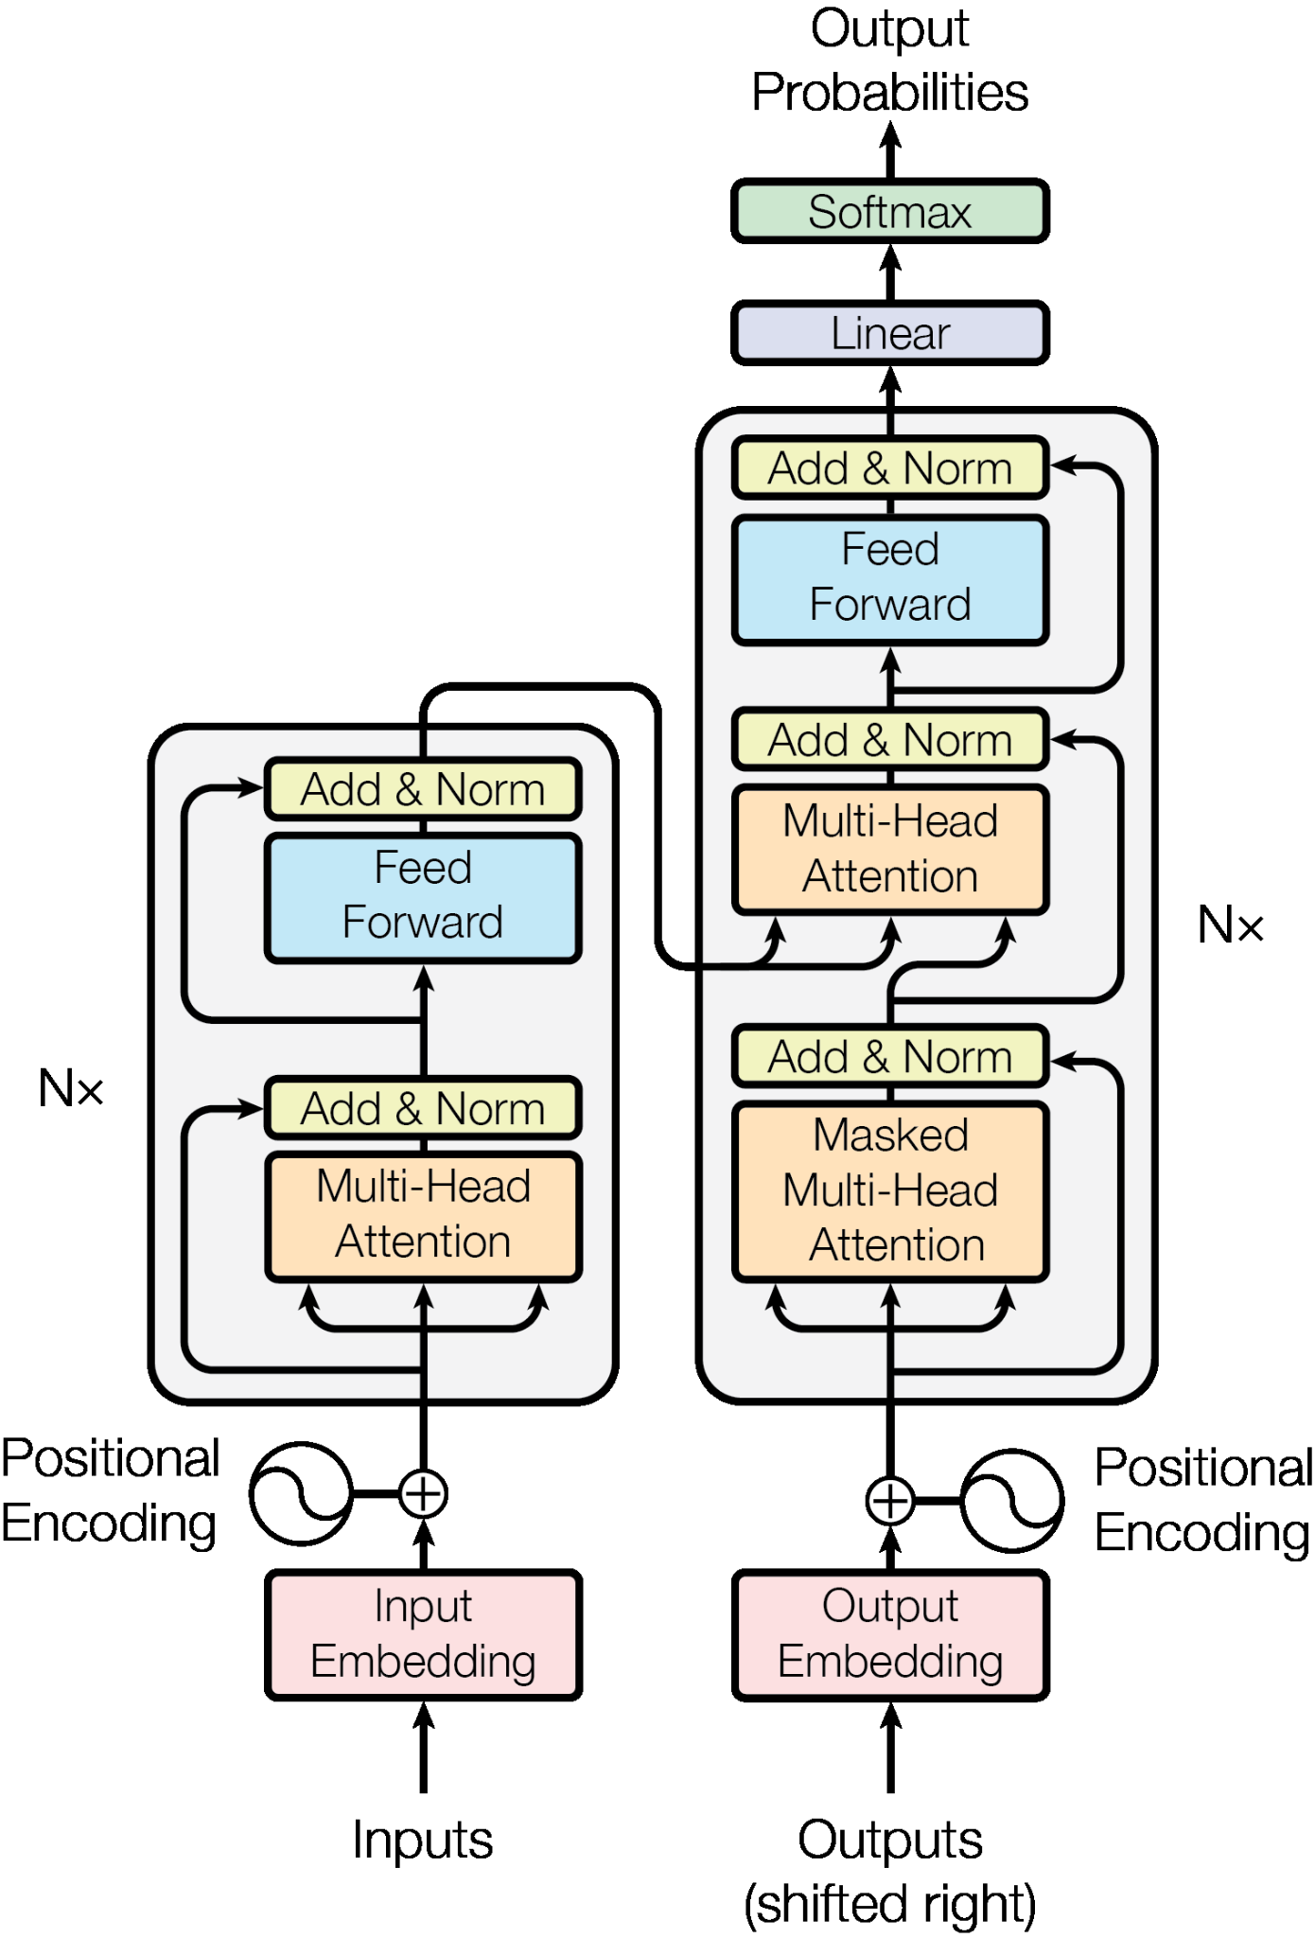
</Methodology - Transformer
Notes:
Gautham
We trained a Transformer model to take in the input data and return predictions. The architecture used is similar to the one used in the Automatic Speech Recognition with Transformer tutorial for Keras. We ultimately ended up only needing to finetune a small part of the model as we were able to treat the ASL Fingerspelling recognition problem similar to speech recognition. In both cases, we have to predict a sentence from a sequence of data - just that our problem involved mediapipe landmarks instead of sound files.
A key function of the Transformer encoder was processing landmark coordinate features as input; we applied convolutional layers to downsample them and process local relationships. When processing past tokens in the decoder, we sum positional embedding and token embedding, which were calculated by functions we had set up as part of the Transformer code. The positional encoding provides a mechanism for the Transformer to capture the relative positions of input tokens. It was summed with the token embedding to form the inputs for the Transformer. The embedding style gave our Transformer knowledge of the relative positioning of input tokens; by directly including it in the input of the deep learning model, we allow the model to form connections to the output and learn the meaning of the embedded positional data during the training process.
The Encoder function consists of a multi-headed attention operation followed by dropout, layer normalization, a feed forward layer, and a second dropout and layer normalization operation. These are accomplished using Keras neural network functions.
The Transformer Decoder uses the input token encodings to predict a sequence of characters
This model takes landmark coordinates as inputs and predicts a sequence of characters. The target character sequence, which has been shifted to the left is provided as the input to the decoder during training. The decoder employs its own past predictions during inference to forecast the next token. The Levenshtein Distance between sequences is used as the accuracy metric since the evaluation metric for this contest is the Normalized Total Levenshtein Distance.

Slide 6




</Results
Notes:
Jamie - 30 seconds
Now that we’ve talked about how we approached the research, preprocessing, and Transformer model, let’s get into the results. The images above are examples of some predictions our model made. There are some good instances, where the model is able to predict the first portion of the letters with minor errors, but often times the second half of the phrase is mostly incorrect. But, the letters predicted typically are derived from the target phrase but not always in a completely matching order.

Slide 7
</Results
Notes:
Jamie - 30 seconds
Now that we’ve talked about how we approached the research, preprocessing, and Transformer model, let’s get into the results. The images above are examples of some predictions our model made. There are some good instances, where the model is able to predict the first portion of the letters with minor errors, but often times the second half of the phrase is mostly incorrect. But, the letters predicted typically are derived from the target phrase but not always in a completely matching order.

Slide 8
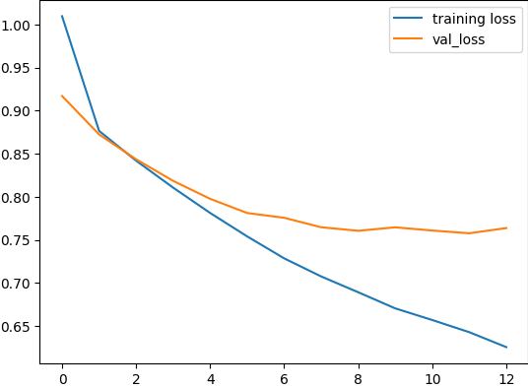
</Results
“2 a-e -aroe”
Notes:
Jamie - Results Pt 2 to show how loss diverges - 1 min
Here is a diagram of our training and validation loss. We ran 13 epochs, and we can see that around epoch 12 the validation loss starts to diverge from the training loss. This suggests that our model is overfitting, which makes sense for various reasons:
We ended up only using about 20% of the dataset which was already 25 GB, of which we used an 80:20 training validation split. This means that our model was trained on only 16% of the full dataset and could have learned predictions that aren’t generalizable to the rest of the data. We can see this in some of the predictions, where the model learned phases like “www.” for a website, but applies them in situations that are inaccurate.
In the future, we could also try to strengthen our model by conducting cross validation and other hyperparameter tuning to make the model perform better.
We looked at how we might improve our prediction loss results, and from our research we actually found a fun paper by a Kaggler who proved that there is one dummy phrase, “2 a-e -aroe” that you can use to replace poor predictions that is actually statistically desirable given the dataset!
With more time, we could look into these different augmentations to reduce overfitting and optimize loss.
Next, Fabiola will walk through how some of our predictions changed over epochs.

Slide 9



EPOCH
#1
Notes:
Fabiola
We are going to do a deep dive on how the predictions change as the model refines itself. in the next few slides, we are going to be looking at the epochs. For the model, we trained it for 13 epochs and we are going to be looking at 4 out of the 13 epochs. These 4 epochs we are looking at have the same 3 target phases and below it is the prediction. -------For epoch 1, we can see that the prediction model did not predict the first character right. and we've noticed that if it gets the first character wrong, the rest of the phrase is predicted wrong.

Slide 10



EPOCH
#5
Notes:
Fabiola
For epoch #5 we can see for the first two it got the first few characters right but then the accuracy drop for the rest of the phrase. For the last example, we would expect it to be like the first 2 but it did not get the first character right so gives us the same results as epoch #1.

Slide 11



EPOCH
#9
Notes:
Fabiola
For epoch #9 we are getting the same results as epoch #5 with the first 2 examples having the first few characters accurately predict them and the third not even close to the target phrase. One major difference from epoch #5 is that in the first prediction it got most of the characters right, even the last word, but the middle part of the phrase, it got the right characters but in different places.-

Slide 12



EPOCH
#13
Notes:
Fabiola
For epoch #13, we got the same results for as epoch #9 with first two examples being more accurately representing the target phrase while the last one is still nowhere close to the target phrase.
looking at the predictions for each of the epochs over time, we can see that the model is able to predict phrases with more accuracy over time
and if we were able to train it for more epochs we can see that accuracy for the prediction should go up

Slide 13
</Discussion
Notes:
Gautham

Slide 14
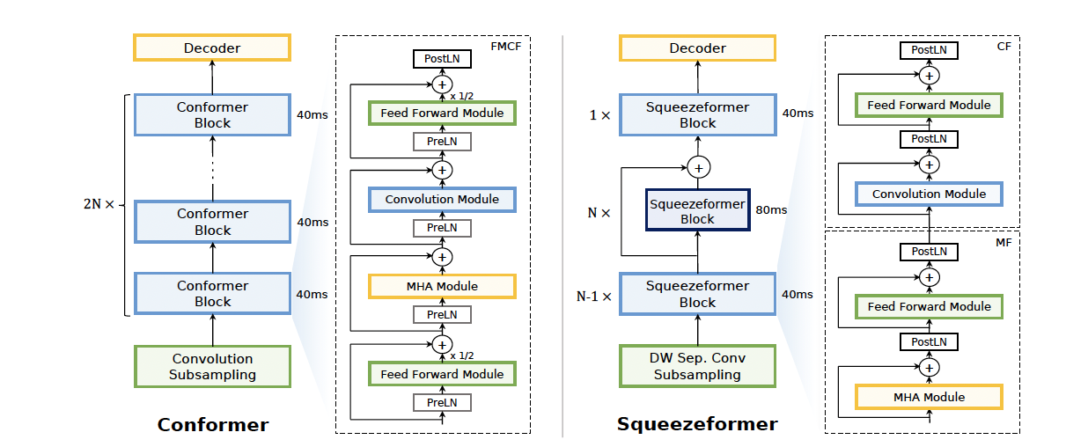
Modern Automatic Speech Recognition (ASR) Methods

Slide 15
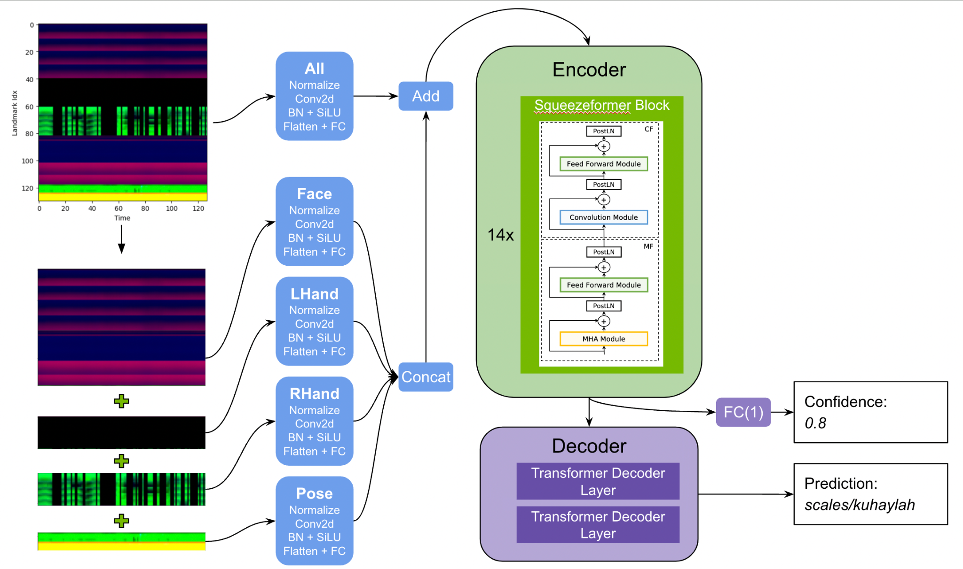

Slide 16
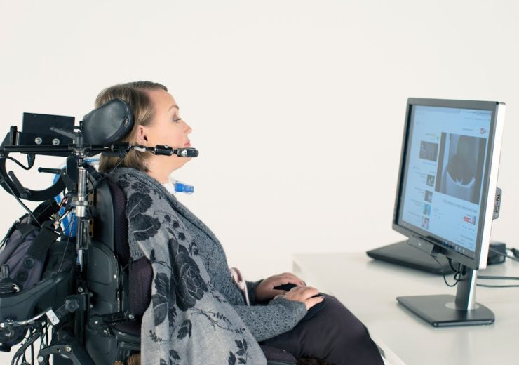
</Conclusion
Assistive Technology
Learned more about AI…
The “AI Process”
Software
Architecture
Point of Reference
Implementation is more difficult than it seems!
Notes:
Harry

Slide 17
Thank You!
Questions?
Notes:
Harry

